Slide 1
Topics in Land Surveying: Subdivisions TREC #7220
Tim Howell, RLS TREC Instructor #1556

Slide 2
Controlling Factors of subdivisions
Road Frontage
Lot Width
Soil Type
Land Slope
Flood Plane
Economic Feasibility
Road Construction
Utility Installation
Lot Size
Zoning
Public/Private Utilities
Intended Use

Slide 3
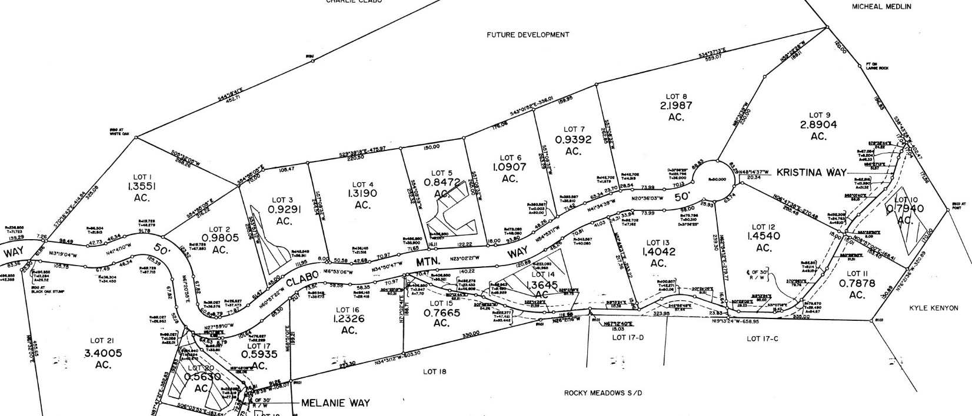
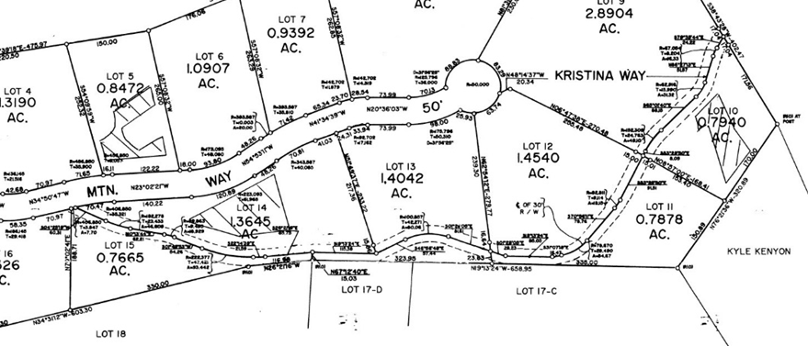
Road Frontage
Road frontage is the distance along a public or (approved) private road.
Requirements are region specific and range from 25-50 feet of “useable” frontage per lot.

Slide 4
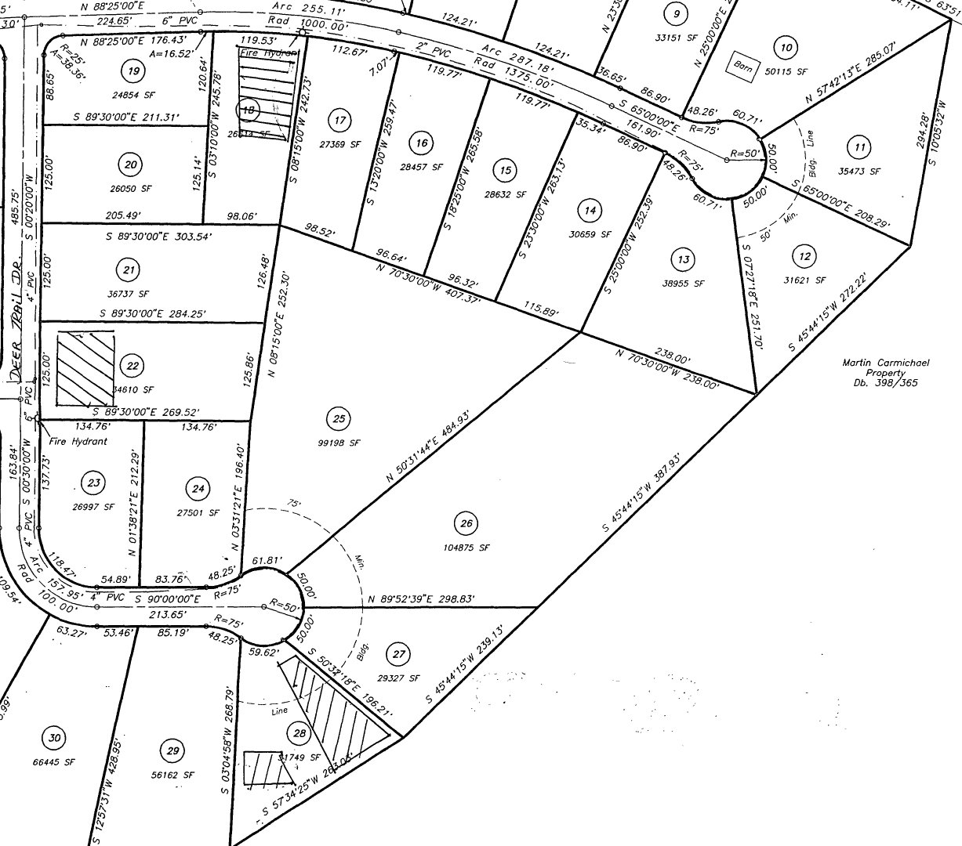
Lot Width
Not only do some jurisdictions have minimum lot widths, they also have variable setbacks based on the width of the lot.
So, a lot must be a certain width before you can build.

Slide 5
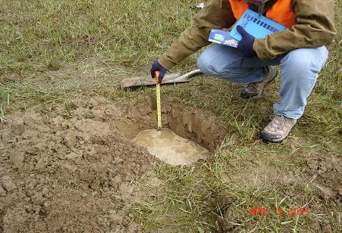
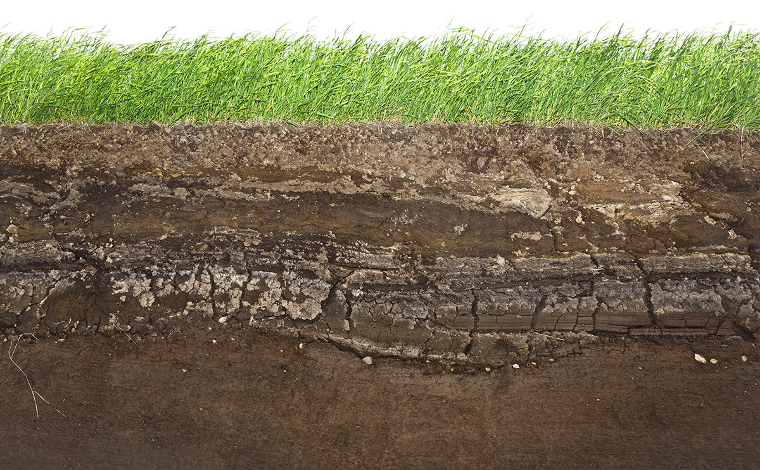
Soil Type
When dealing with property without public sewer service, subsurface disposal is the preferred alternative.
A soil scientist must determine the types of soils on the land and its suitability for a septic system.
Soils have different absorption rates. As the rate decreases, the health department may require peculation testing.
The lower the rate, the more field line is required and subsequently the more land is needed requiring increased lot sizes.

Slide 6
Land Slope
Many municipalities now have a requirement controlling the size of the lot based on the average slope of the property.
The steeper the property, the larger the minimum lot size.

Slide 7
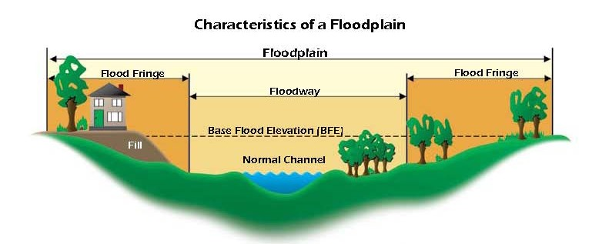
Special Flood Hazard Area
Beyond the need to build above the base flood elevation, many planning regions have adopted the policy that you must have a building site OUTSIDE of a special flood hazard area on every lot.

Slide 8
Economic Feasibility
Road Construction
Utility Installation

Slide 9
Minimum Lot SIze
Generic Lot Sizes (base on Sevier County)
Lot with no public utilities* 0-29% slope – 30,000 ft² 30-49% slope – 2 acres 50% or greater – 3 acres
Lot with one utility <30% slope – 25,000 ft²
Lot with both Utilities 7,500 ft²
* If requiring percolation testing 40,000 ft²
Decide what the intended use of the property is and determine how large of lots are desired.
Zoning can also control size and building setbacks.

Slide 10
Initial Analysis

Slide 11
Preliminary Plan

Slide 12
Boundary Survey

Slide 13
Revised Preliminary Plan

Slide 14
“Final” Map

Slide 15
New Final Map

Slide 16
Topics in Land Surveying: Subdivisions TREC #7220
Tim Howell, RLS TREC Instructor #1556

