Slide 1
Legal Description Comprehension
Topics in Land Surveying:
TREC #7223 Tim Howell, RLS TREC Instructor #1556

Slide 2
Types of Descriptions
Platted Description
Metes and Bounds
A platted description is similar to the following:
“…all of Lot No. 421, Block 44…as shown by map of record in Plat Book 1, page 23, in the Register’s Office for Roane County, Tennessee…”
A complete perimeter description where as each course is described in sequence in a constant direction with adequate information to recreate it on the ground.

Slide 3
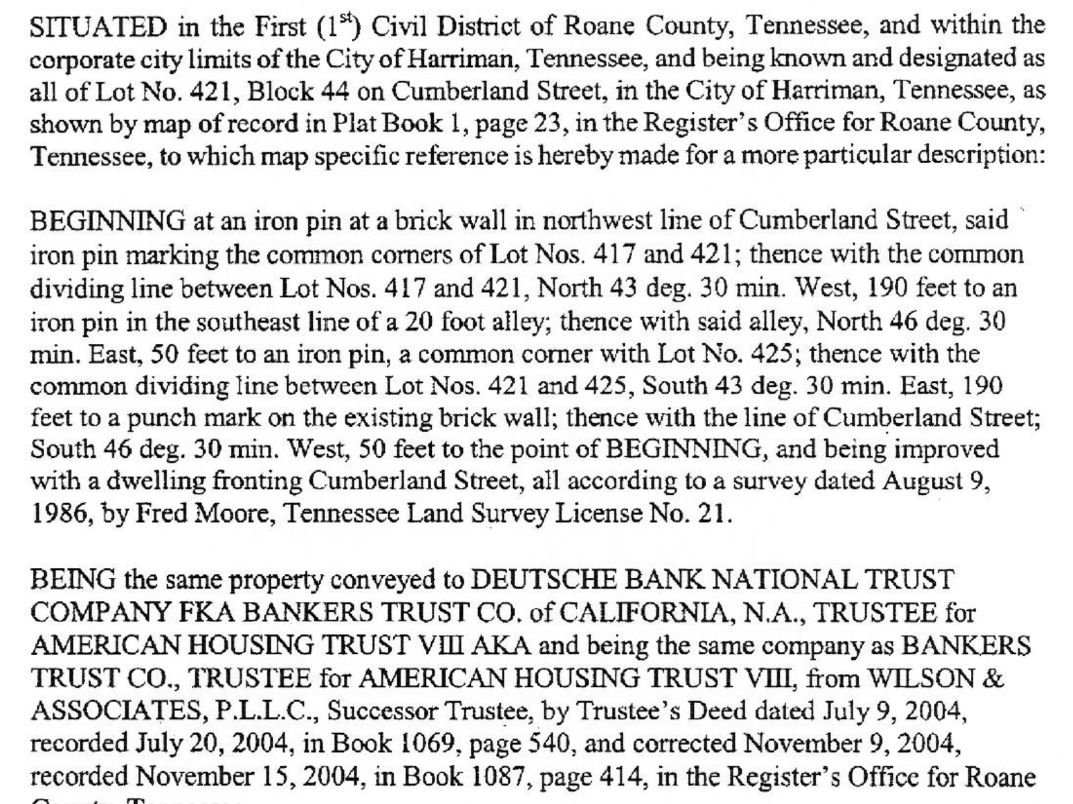
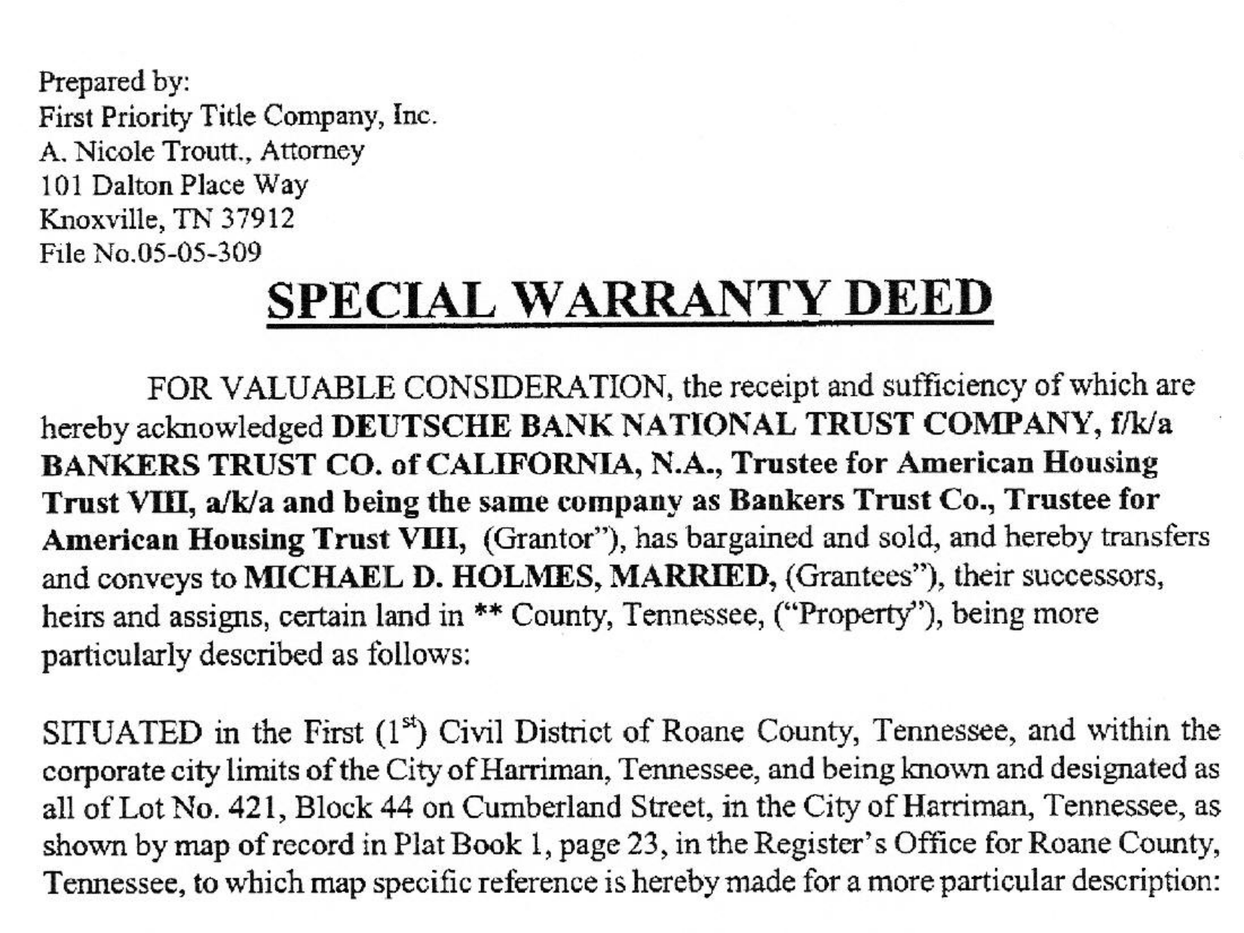
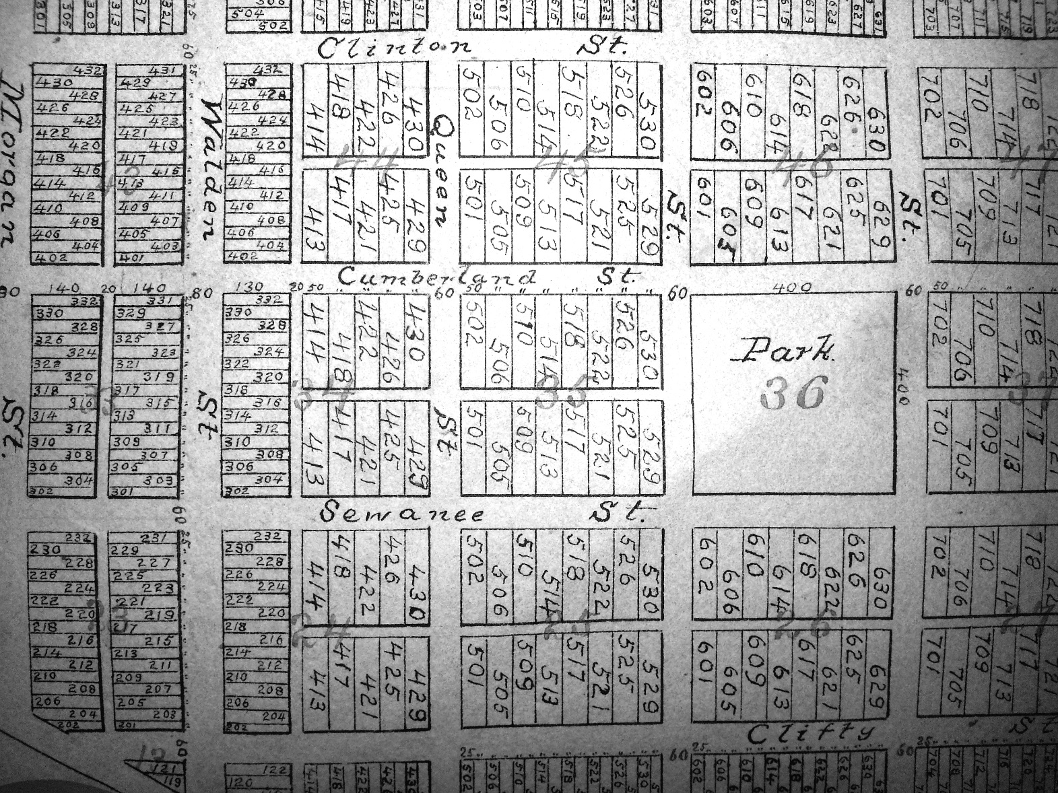
Preparer
Participants (Grantor-Grantee)
Purpose Statement
General Location
Description
Reference to Ownership
Signatures
Deed

Slide 4
Converting Distances
1 US Survey Foot = 1 foot
1 Rod or Pole = 16.5 feet
1 Chain = 100 links or 66 feet*
1 Meter = 3.28083333 feet
1 Mile (statute) = 5280 feet
1 inch = 0.083 feet

Slide 5
Understanding Angles
N
0°
N18°16’22”W
W
90°
E
90°
S18°16’22”E
0°
S

Slide 6
Elements of a curve
Radius
Length (arc length)
Tangent
Delta (Δ)
Chord Distance
Chord Bearing

Slide 7
Curves

Slide 8
Slope

Slide 9
Hierarchy of Evidence
Senior Rights
Writings
Intent of Conveyances
Calls for surveys
Monuments
Natural
Artificial
Record
Measurements
Direction
Distance
Area

Slide 10
Elements of a good description
Must contain enough language to convey a sense of what is being described
Include all the elements shown on a plat that is feasibly possible.
Tell the story of the boundary. Describe it so anyone can picture it.
Have enough elements of the dimensions to reconstruct the survey.
Legal Description
Describe some more.

Slide 11
Examples…

