Slide 1
Basic Surveying
Tim Howell

Slide 2
Surveying defined.
Land Surveying: The science and art of determining relative positions of points above, on, or beneath the surface of the earth, or establishing such points. ~Brinker and Wolfe
Forensic: belonging to, used in, or suitable to courts… ~Merriam-Webster

Slide 3
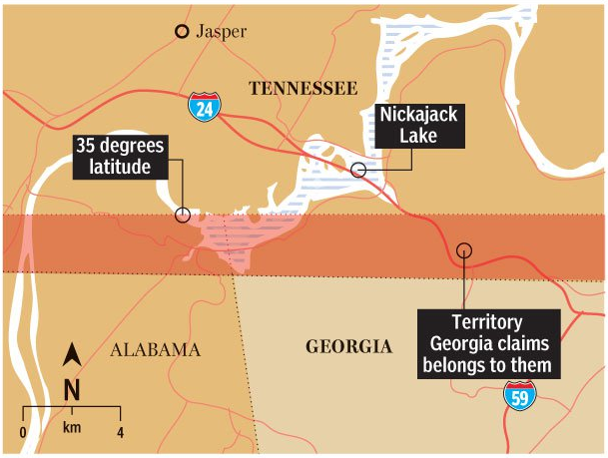
Georgia-Tennessee Line

Slide 4
Distances
Rod/pole/perch
Chain and links
Decimal feet or meters
127.18’ = 127'-2 1/16“
1 inch equals 0.08333 feet
1/16 of an inch equals .0052 feet

Slide 5
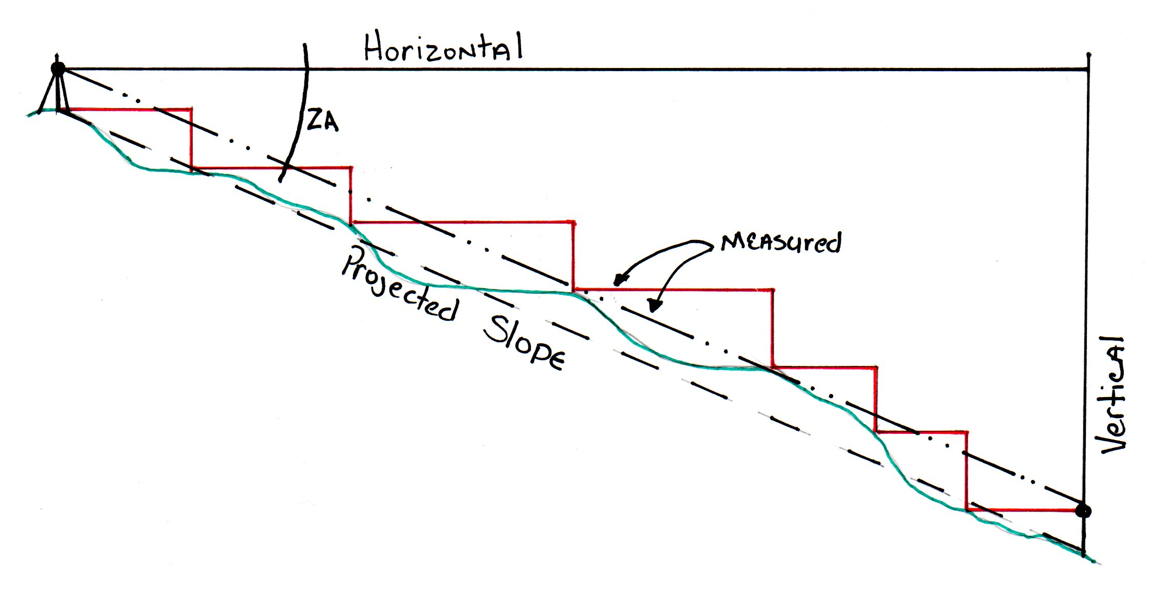
Horizontal, vertical, and slope…

Slide 6
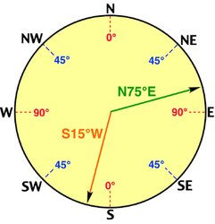
Bearings
Read as “degrees, minutes, seconds”
° = degree
‘ = minutes
“ = seconds
360 degrees in a circle
60 minutes in a degree
60 seconds in a minute

Slide 7
Significant Digits
Distances
Angles
Pole
½ or ¼ = ± 4-8 feet
Chain
½ or ¼ = ± 16-33 feet
Foot
Tenth = ± <1 foot
Hundredth = ± <0.1 feet
Degree @ 100’
± 1.75 feet
Minute @ 100’
± 0.029 feet
Second @ 100’
± 0.0005 feet

Slide 8
Error of Closure
Tennessee State Minimum Standards
Urban Survey – Category I = 1:10,000
Rural Survey – Category II = 1:7,500
All Others – Category III = 1:5,000
1 acre city lot with an 835'± perimeter is allowed 0.083' or 1 inch of error
10 acre rural tract with 2640' of perimeter can have 0.352' or 4 ¼ inches of error
A 500 acre tract can be easily allowed 2.5' of error.

Slide 9
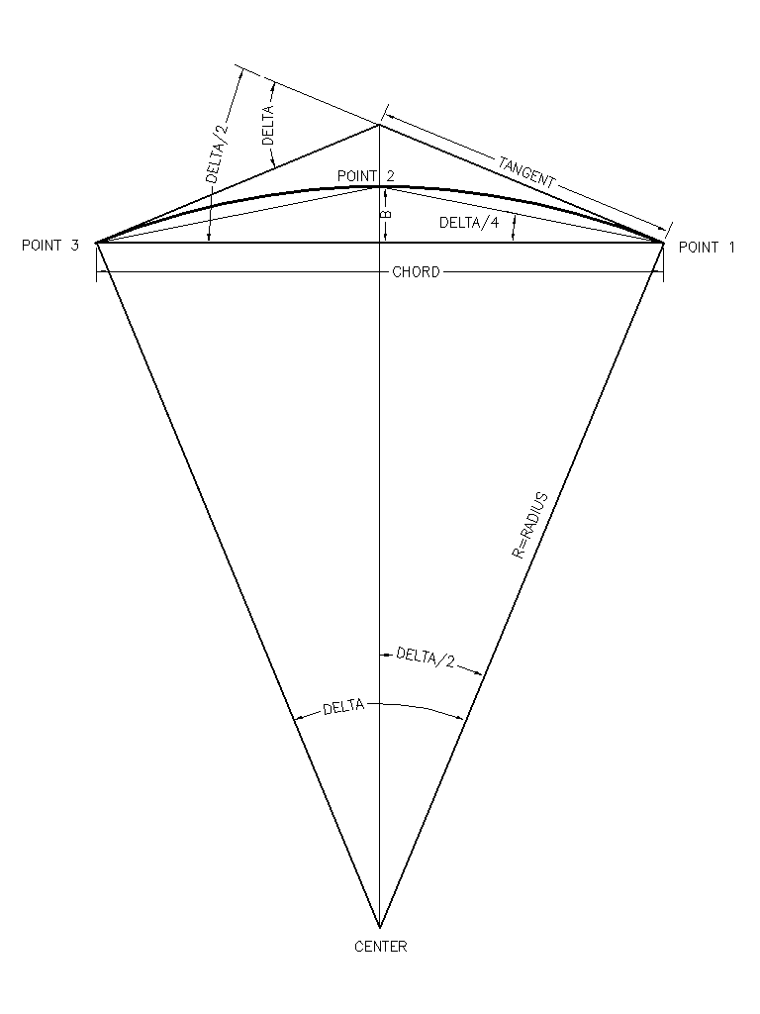
Elements of a curve
Radius
Tangent
Delta (Δ)
Chord Bearing
Chord Distance
Length (arc length)

Slide 10
Two types of surveyors…
Mathematically inclined
Legally inclined
Holds that dimensions on a deed supersede all others and that a surveyor isn’t there to make “legal” inferences but to document and re-establish if the variation is too great.
*Creates “pin cushion” corners.
Also referred to as “fence line” surveyors.
Tend to hold field evidence over math. Believes in the hierarchy of evidence and tries to abide by it.
*Creates discrepancies between deeds and the real world.

Slide 11
Hierarchy of Evidence
Senior Rights
Writings
Intent of Conveyances
Calls for surveys
Monuments
Natural
Artificial
Record
Measurements
Direction
Distance
Area

Slide 12
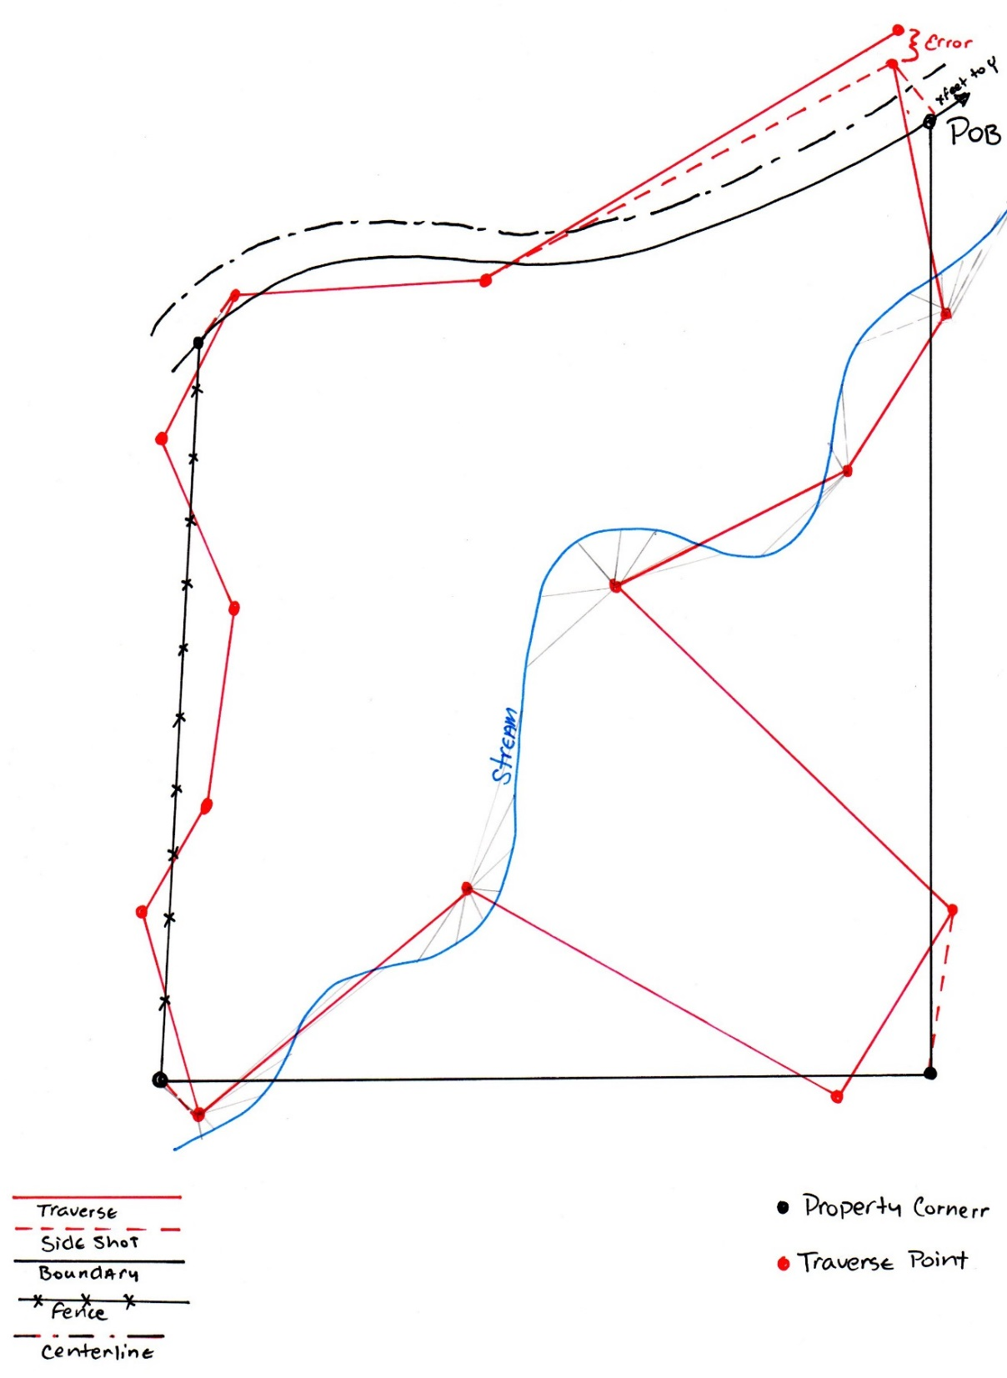
Point of Beginning Traverse Traverse Points Closure

Slide 13
Placing an order…
Corner Location
Alta Survey
Mortgage Survey
Lot or Boundary
Marking Lines
Topograpic
Legal Description
Elevation Certificate
Site Plan
Development
Subdivision
PUD
Condominium

Slide 14
Things that affect costs
Topography
Ground cover
Area
Boundary
Region
Level of difficulty
Age or previous survey
Lack of previous survey
How soon is it needed?
Level of Detail
Additional Services
Marking line
Topograhic survey
ALTA/ACSM
Liability

Slide 15
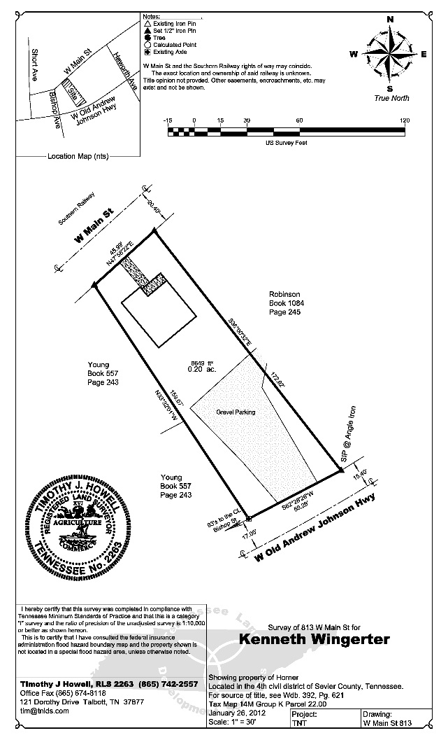
What happens after you call…
Research
Reconnaissance
Measurement
Calculation
Monumentation
Drawing
Submission/Delivery

Slide 16
Flood Definitions
FEMA
FIRM
Elevation Certificate
LOMA
Floodplain
Floodway
Special Flood Hazard Area
100-year flood
500-year flood
Base Flood Elevation
Flood Vent

Slide 17
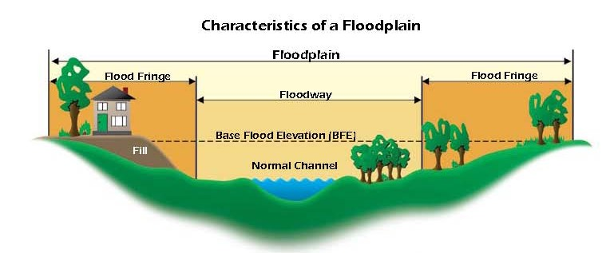
Waterway Cross Section

Slide 18
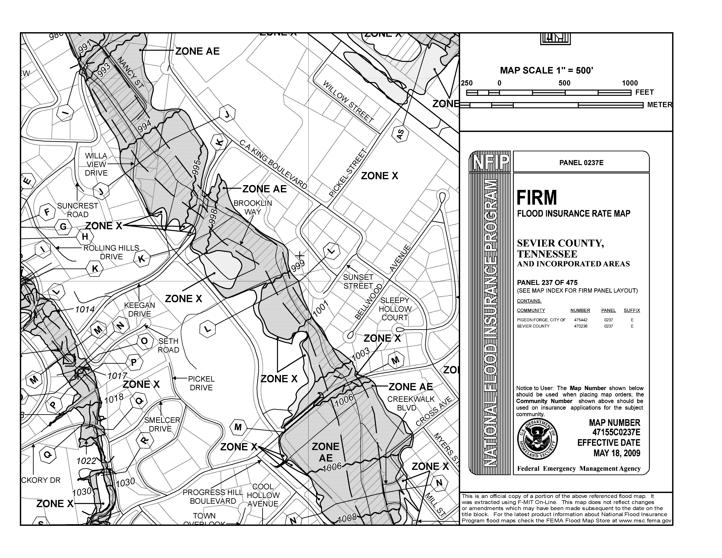
FIRMette

Slide 19
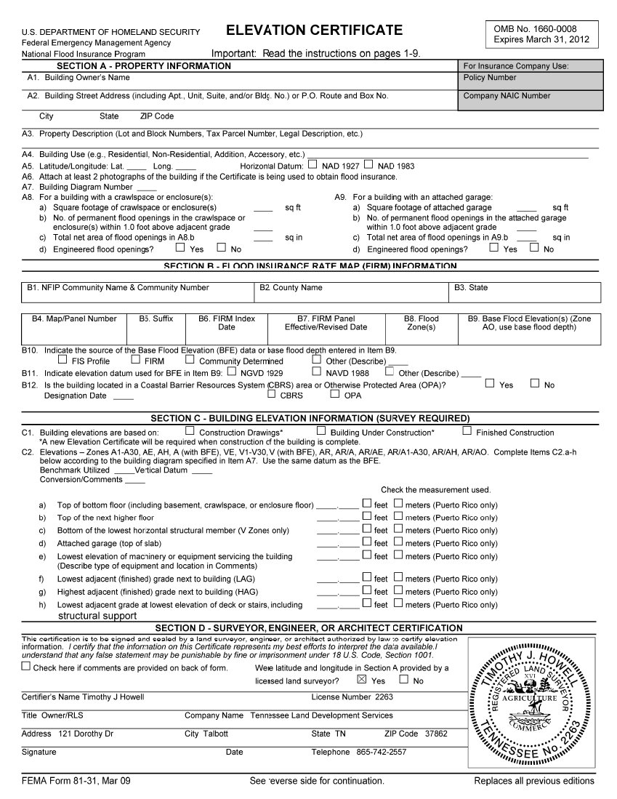
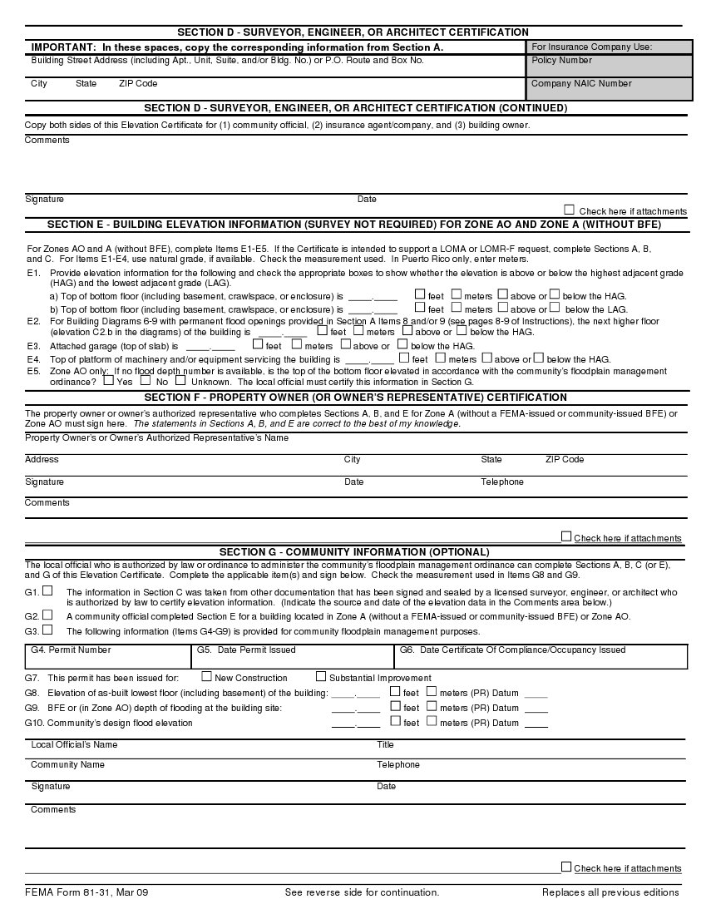
Elevation Certificate

Slide 20
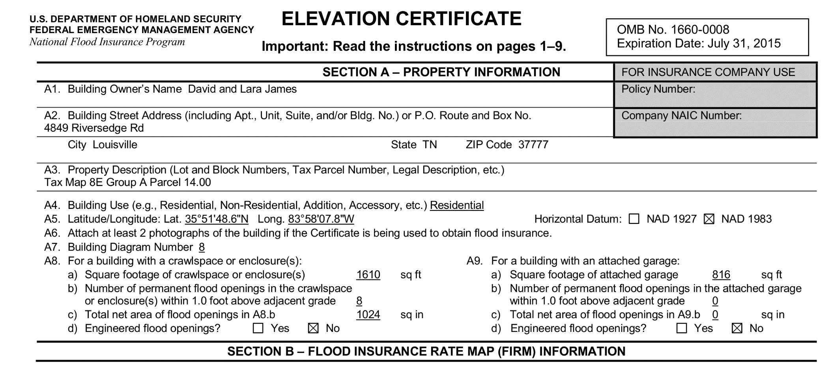
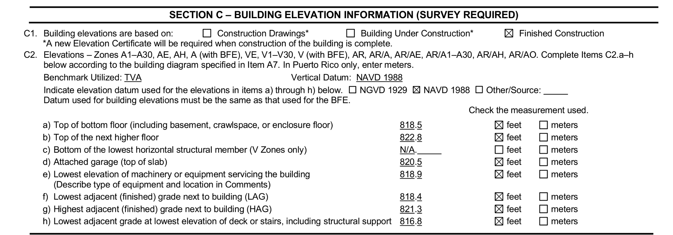
Elevation Certificate

Slide 21
Thank you
Timothy J Howell, RLS
121 Dorothy Dr Talbott, TN 37877
865-742-2557
tim@tnlds.com
www.tnlds.com

